Slide 1
Technology Budgets and Rotation Cycles
https://tinyurl.com/BrainStorm19

Slide 2
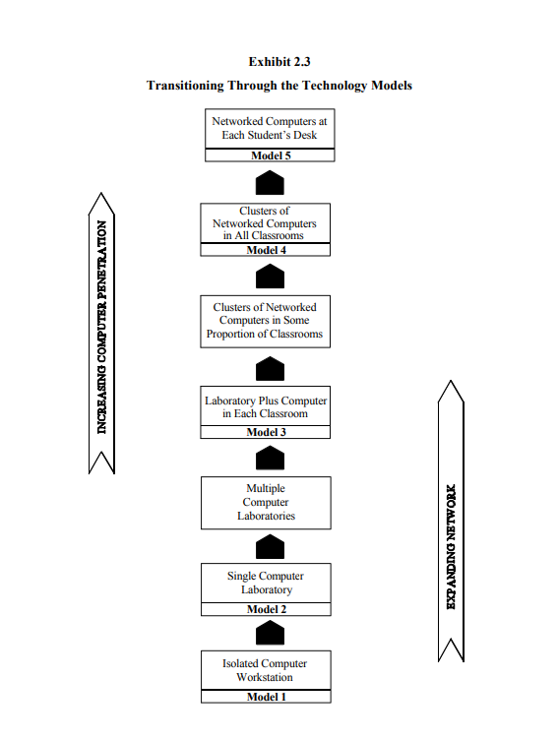
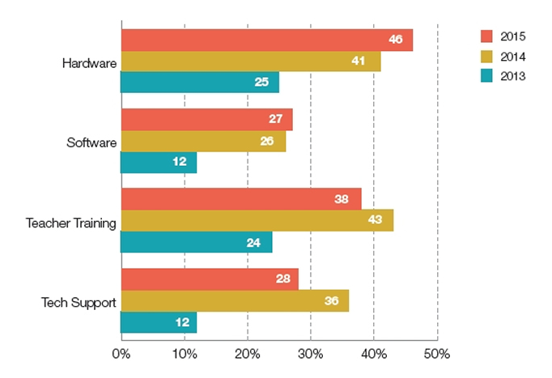
Evolution of Technology

Slide 3
Budget Sheet Examples
https://goo.gl/AwcFXg
https://goo.gl/L3Vfvm

Slide 4
Good Budgeting Rules
Aligns to goals. Budgets ought to be a subset of a larger technology plan that's tied directly to district and school goals.
Is transparent. My technology department's budget is available districtwide in a Google Docs spreadsheet. Transparency also depends on using language that is understandable to educators and the general public.
Is specific. I do zero-based budgeting every year. This means starting from scratch and itemizing every technology expense that the district needs to cover in the coming school year.
Includes stakeholder input. An advisory committee (Guiding Coalition) is a great help for the technology budget maker. A good advisory committee will also insist on some kind of assessment that helps answer the question, Did expending funds in this way have the anticipated result?

Slide 5
Rotation Cycles
A sustainable technology practice means
Not purchasing more technology than a school can regularly maintain, upgrade, and replace. For example, let's say that Johnson Middle School has 500 students and 20 classrooms. We want a Windows computer in each of our classrooms (20) and a 1:1 student chromebook ratio throughout the school. That's 520 computers in all. Computers much more than five years old become unreliable. If we're going to replace our computers every four years, we need to purchase 25 percent of them new each year. Therefore, our annual Windows computer budget needs to be .25 replacement rate × 20 computers × $600—or $3,000—and our annual Chromebook budget needs to be .25 x 500 x $300---or $37,500 this year and every year from now on. If you don't maintain the technology, you get unreliable computers that teachers won't use.
Rotating the technology. Let's give almost everyone a new computer for the price of a single computer lab. Here's how it works: The tech ed department buys new machines with RAM and fast processors needed to run its PLTW software. The replaced tech ed machines go to the business department, where they will be used to do desktop publishing, presentations, and office practice. The library gets the hand-me-downs from the business department for research and multimedia use. Finally, the oldest machines go from the library to the English department's writing lab. Recycle the oldest stuff and collect a little income.
Do not keep computers going that are at end of life. Once a computer is more than five years old, we don't fix it. Put the old machines that will be recycled when they break into non-mission-critical places.

Slide 6
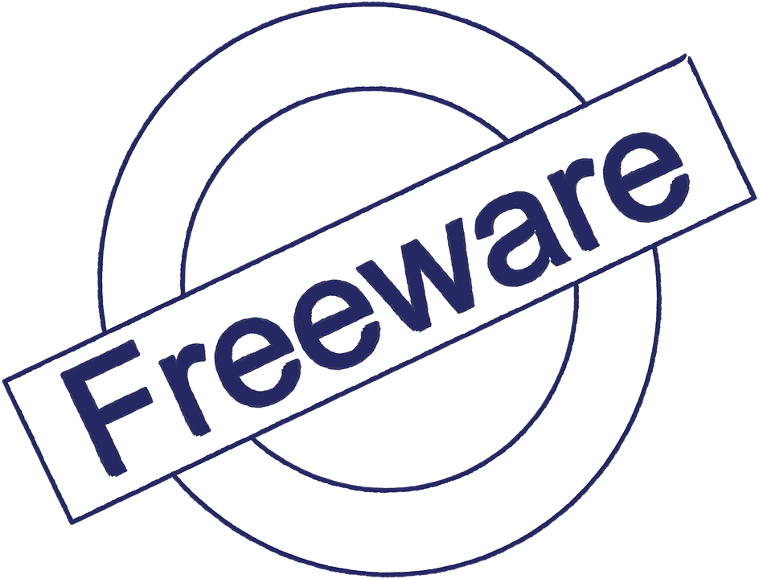
Take advantage of free software.
One easy place to save a good deal of money in the technology budget is on software. I'm not advocating becoming a pirate. Instead, take a serious look at some high-quality software that's now available at no cost. There are basically three types of no-cost software:
Open-source software uses code that the creator has placed in the public domain and that a large body of users then rewrites and extends. The Linux operating system is probably the most famous open-source product available.
Minimally featured versions of commercial products are made available by a producer who then hopes that features or capacity available only in the purchased version will sell the software. Animoto and Dropbox work this way.
Web-based software applications that derive revenue from advertising are growing in popularity. Yahoo mail uses this economic model.
One "free" technology to think very carefully about is donated equipment. Many businesses and individuals with the best of intentions offer to give computers and other equipment to schools. Too often the equipment is old, incompatible, or in need of repair and licensure. Unless your school really needs the items and the items have at least two years of life left, pass on the offer and avoid the recycling fee.

Slide 7
Head to the Cloud
Cloud computing relies on applications and file storage that reside on the Internet, with minimal resources stored on the local computer's hard drive. A major advantage, then, of cloud computing is that you can work on any project anywhere, regardless of the computer you're using.
But cost savings are also important. Unlike software that resides on computer hard drives, web-based applications are often provided at no cost to the user. Tools such as Google Apps for Education often have a surprisingly full feature set and are compatible with commercial programs.
You can lower your school district's computing costs by using inexpensive computers just to access the cloud. Chromebooks are inexpensive, and file storage and basic applications are free.
By using Google Apps for Education we are greatly reducing our hardware, software, storage, printing, and support costs.

Slide 8
Enforce standardization through single-point purchasing.
As a rule, I'm against education monocultures. I've yet to see one activity, one teaching style, or even one type of schooling that works for everyone.
But technology standardization has some definite advantages, including cost savings. Standardizing on technology equipment, software, and services
Increases bulk purchase discounts.
Decreases inventory of supplies and parts.
Increases the amount of time devoted to training on multiple products.
Decreases the need for technical support.
Increases the likelihood of compatibility with legacy systems.
The only way to create such standardization is by having an enforced policy that states that all technology purchases need to be made through a single department.

Slide 9
Maximize your E-Rate funding.
For the past dozen years, the Universal Service Fund (E-Rate) has made a major contribution in helping many school districts, including ours, pay their technology bills. Given the amount of money involved and the complexity in properly obtaining and using these dollars, I would recommend the following:
Use an E-Rate consultant. Like a good tax preparer, a reliable specialist will help make sure you apply for all the services for which you are eligible, prepare the documentation completely and in a timely manner, and help answer any auditing questions that might arise. Our consultant has earned her fees many times over.
Work with regional telecommunication consortiums. A number of our services are purchased through a regional consortium that then becomes the E-Rate applicant. The consortium has expertise that the local school district may not—as well as increased buying clout.
Save everything. In case your district is audited, keep all service contracts; all communications from the Schools and Libraries Division of the Universal Service Fund; and any reports related to school demographics, public hearings, and other requirements.
Take the process seriously. E-Rate's application process has strict deadlines and documentation requirements. Rules change yearly. Make E-Rate a priority, read all updates, and attend any training on the process that your state or region offers. Respond quickly and completely if questioned by the Schools and Libraries Division.
Lobby your U.S. representative and senators. Let your congressional delegation know that this is one federal program that's worth its attention. Given schools' increased reliance on E-Rate's networks and telecommunication infrastructure, the program needs to stay solvent.

Slide 10
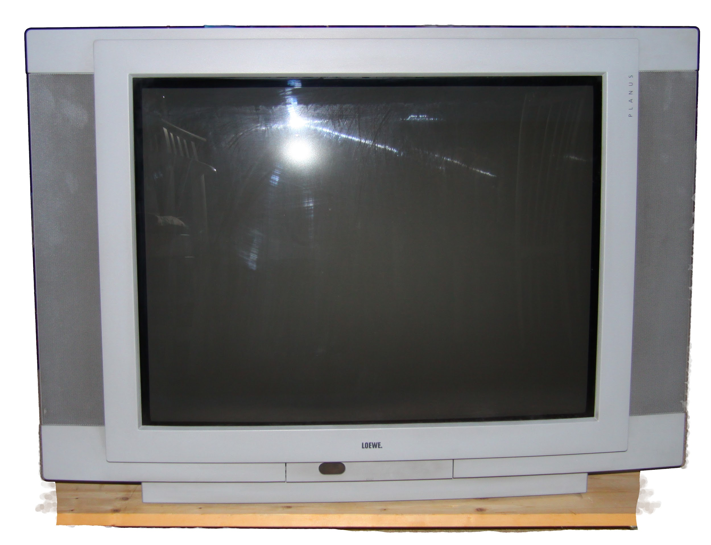
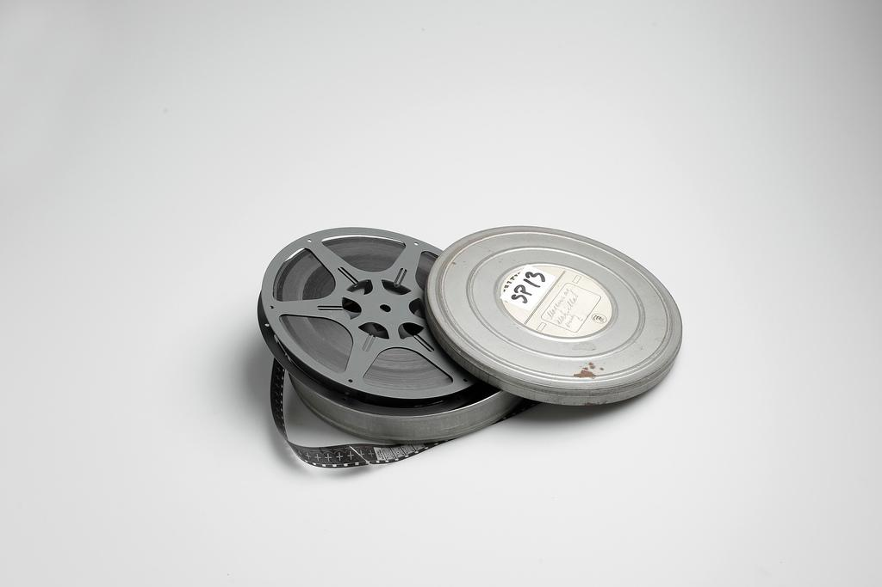
Stop supporting obsolete technologies.
Although you may need to rip the following technologies from some teachers' hands, they are no longer viable:
16mm film projectors
filmstrips
cassette tape players
opaque projectors
Microsoft Works and AppleWorks software
You should also be phasing out these obsolescent technologies:
overhead projectors
CRT television sets
VHS tapes and players
desktop, rather than web-based, software
Budgets need to focus on technologies that still have a long life span, not prop up those that are dying.

Slide 11
Provide sufficient training.
How can you make the most powerful and expensive technology worth absolutely nothing? Drop it? Spill coffee on it? Let an 8th grader hack into it? Perhaps, but a far more effective way is to buy a new system, hardware, or software and not provide sufficient training.
Technology training has three simple but important components. Every device, application, and system needs to come with instructions on
Why it's useful.
How to use it.
How to use it to support teaching and learning.
If serious, formal training isn't part of your technology budget, don't worry much about the rest of it. The shiny things won't get used well anyway.

Slide 12
Next Year
Changes coming
The changes take effect Jan. 1 and will be incorporated into this year's 2019 school budgeting process. The law eliminates the school general fund and replaces it with an “education fund” to “be used as the exclusive fund to pay expenses allocated to student instruction and learning,” according to the Legislative Services Agency. It also creates a new “operations fund” that replaces the capital projects fund, transportation fund and bus replacement fund.
https://goo.gl/bz1Xdo
https://goo.gl/RQZxUP

Slide 13
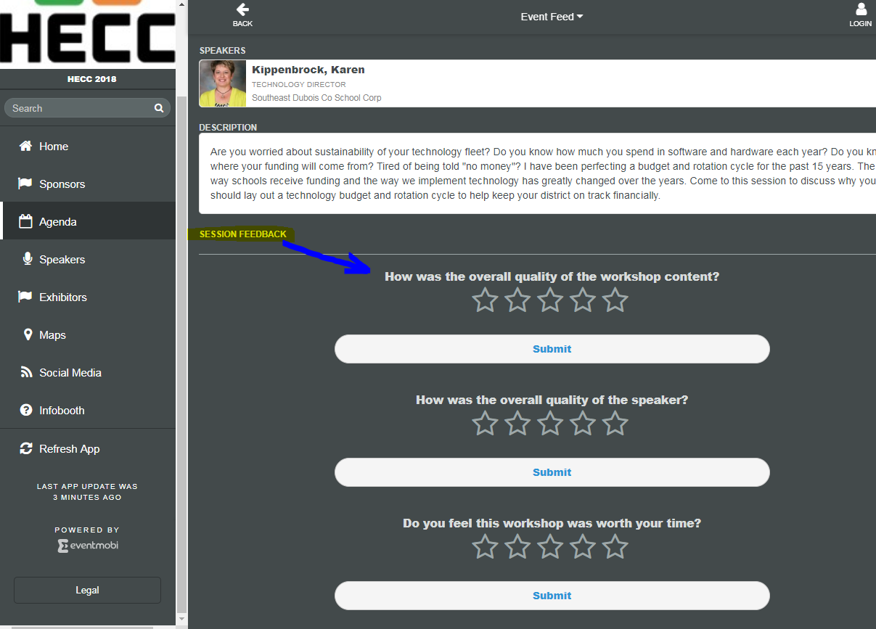
Feedback
Please complete the workshop feedback form at this time. This can be found in the EventMobi App for each workshop/session.
Karen Kippenbrock
Director of Technology
Southeast Dubois Co School Corp
432 E 15th Street
Ferdinand, IN 47532
812-549-9213
karen.kippenbrock@sedubois.k12.in.us

